Slide 1

Shop Manager Project Presentation
University of Camerino
School of Science and Technology
Performance Analysis and Simulation Course
Student:
Marco Scarpetta
Professor:
Michele Loreti
A.Y. 2020/2021

Slide 2
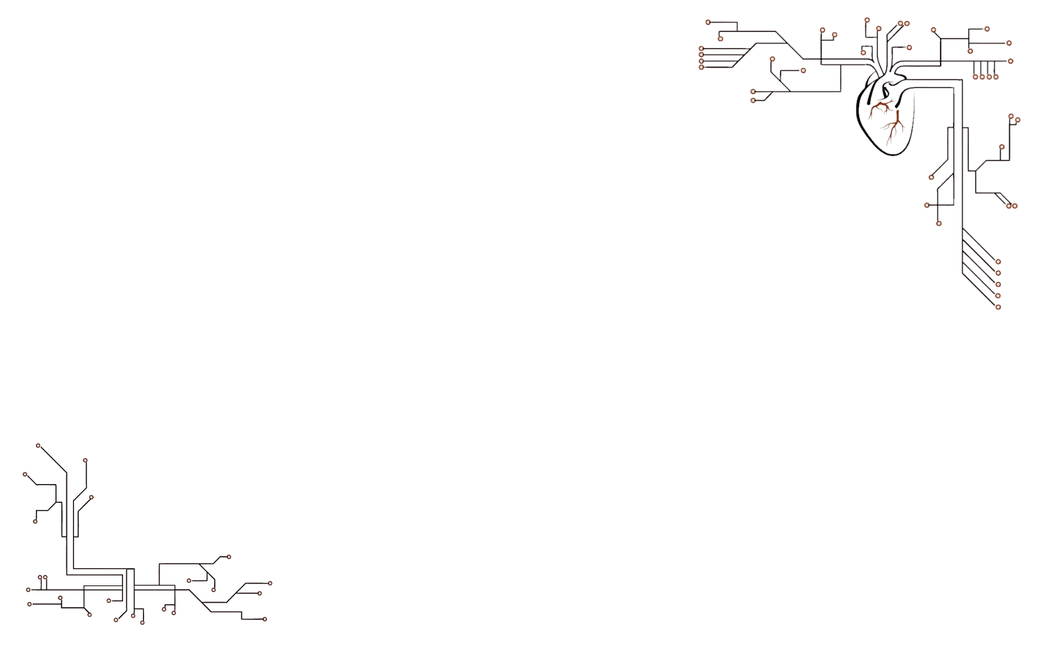

Shop manager
Model a system using Sibilla to simulate the flow of customers in a shop.
Run simulations considering different scenario, then estimate:
Clerks utilization;
Average of waiting customers;
Average of served customers;
Average of customers that cannot enter.

Slide 3
Species
The customer is the focus of the system:
F → potential customer that is still far from the shop;
A → customer arrival;
W → customer that enters the shop and starts waiting;
S → the clerk is serving the customer.
Moreover other 2 species are necessary:
P → to keep track of the available space (thus the customers that can enter);
C → to keep track of the available clerks.

Slide 4
Parameters
N → max number of customers that can wait in the shop;
K → number of working clerks;
Ma → time needed for a new customer arrival
Ms → time needed for a clerk to serve a customer
R → rate used in the transition (set to 1.0 by default)
T → max number of customers that can be involved in the system (20 by default)

Slide 5
Rules and Measures
The behaviour of the system is given by four main rules:
f_to_a F -[ R/Ma ] → A
a_to_w A | P -[ R ] → W
w_to_s W | C -[ R ] → S
s_to_f S -[ R/Ms ] → F | P | C
A custom measure was necessary to keep track the customer that cannot enter in the shop:
E = (#A - (N - #W - #S)) > 0 ? (#A - (N - #W - #S)) : 0

Slide 6
PCTMC Model
The system is then represented by the following PCTMC model:
Vector of species: X =〈 F, A, W, S, P, C 〉
Domain: D = [ 0, T ] × [ 0, T ] × [ 0, N ] × [ 0, K ] × [ 0, N ] × [ 0, K ]
Initial state: d0 =〈 T, 0, 0, 0, N, K 〉
Set of transitions: T = {〈f_to_a, 1F, 1A, R/Ma 〉
〈a_to_w, 1A + 1P, 1W, R 〉
〈w_to_s, 1W + 1C, 1S, R 〉
〈s_to_f, 1S, 1F + 1P + 1C, R/Ms 〉}

Slide 7
Simulation
Python scripts to quickly run several simulations and to automatically obtain the desired plots
5 Scenario were taken into account
Other parameters:
deadline 480
dt 1
replica 100
N | K | Ms | Ma
5 | 2 | 1 | 1
10 | 2 | 1 | 1
10 | 5 | 1 | 1
10 | 5 | 2 | 1
10 | 5 | 2 | 2

Slide 8
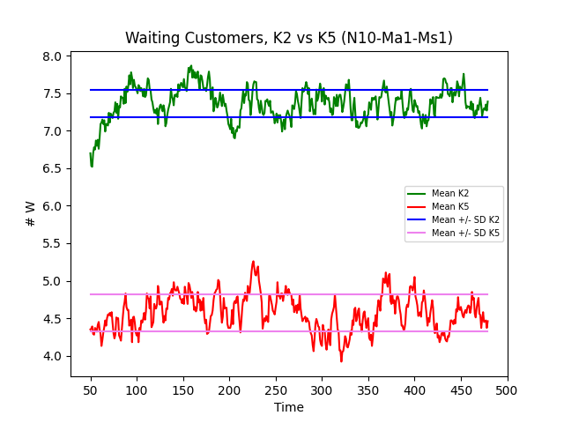
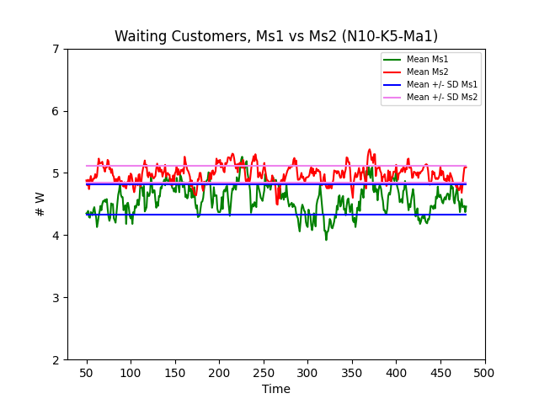
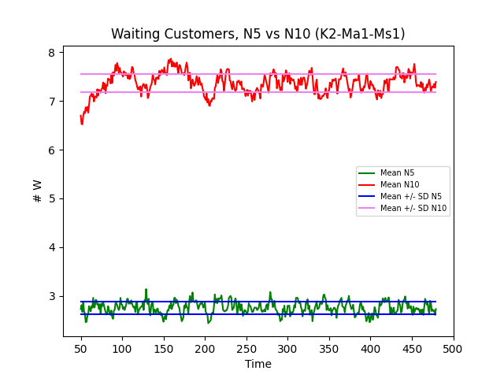
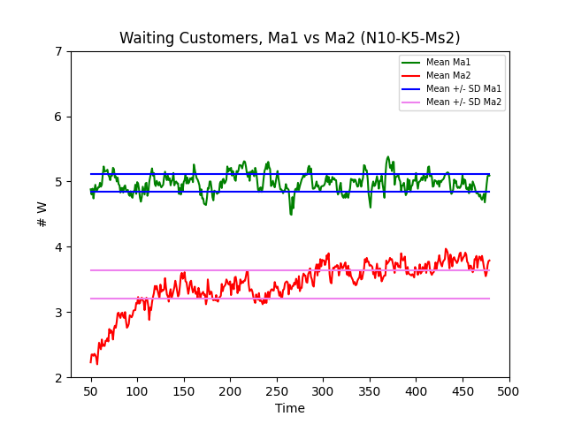
Results - Waiting Customers
More N → More W
More K → Less W
More Ms → More W
More Ma → Less W

Slide 9
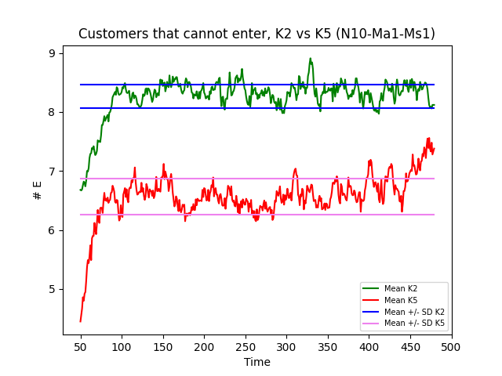
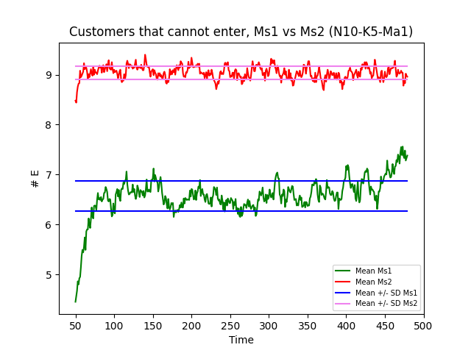
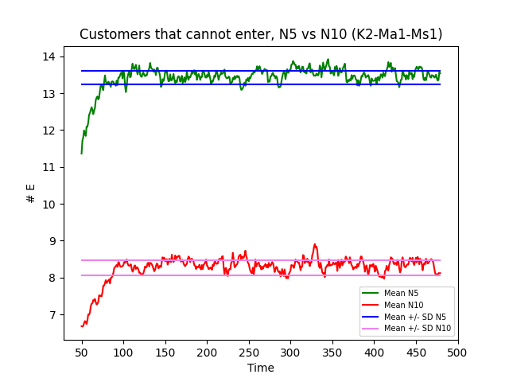
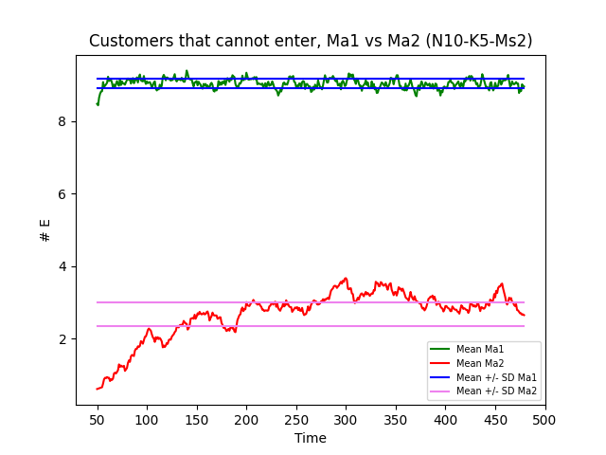
Results - Customers that cannot enter
More N → Less E
More K → Less E
More Ms → More E
More Ma → Less E

Slide 10
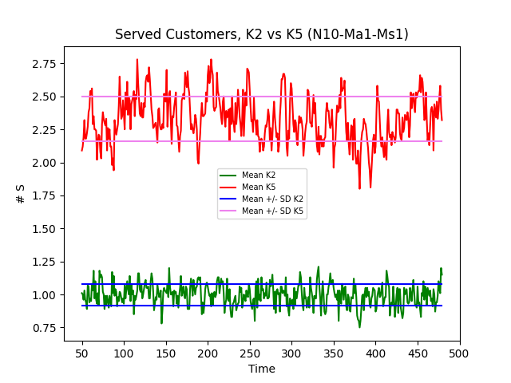
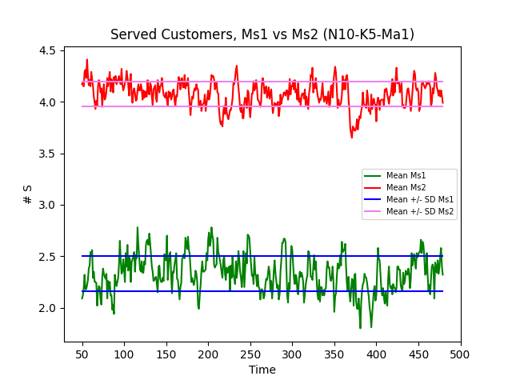
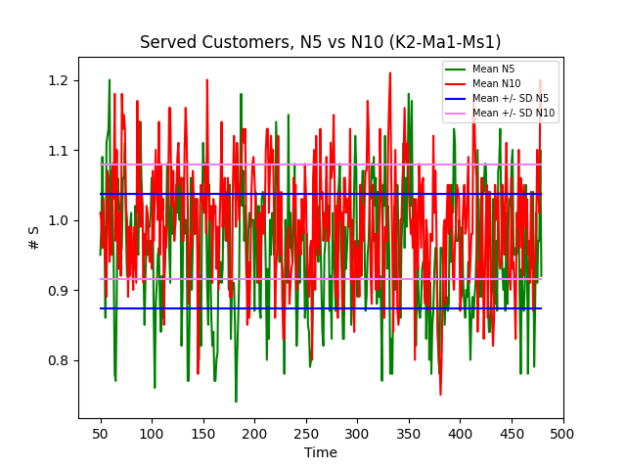
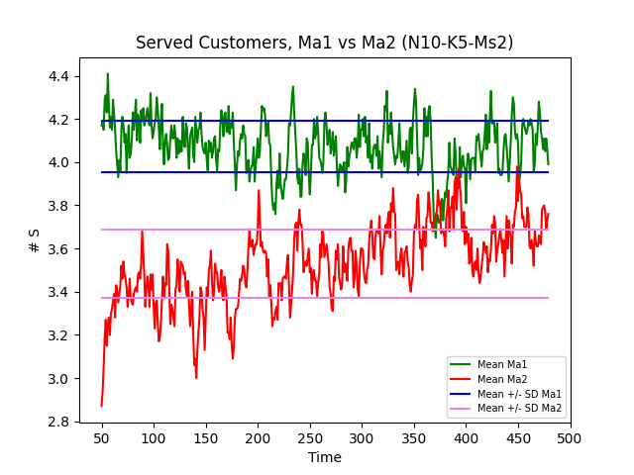
Results - Served Customers
More N → Same S
More K → More S
More Ms → More S
More Ma → Less S

Slide 11
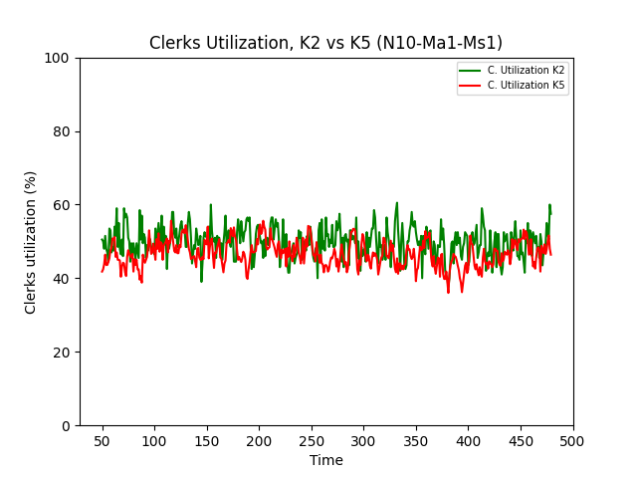
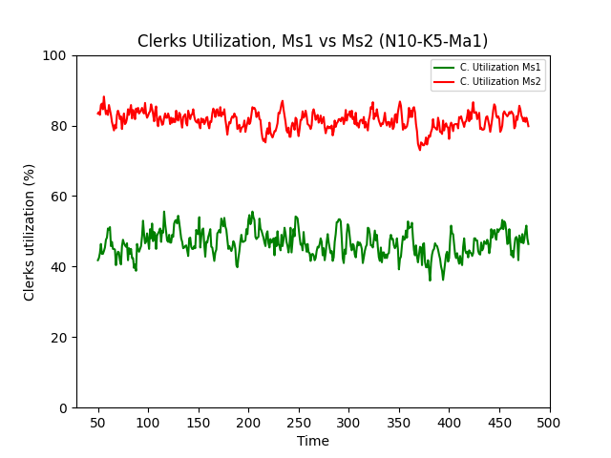
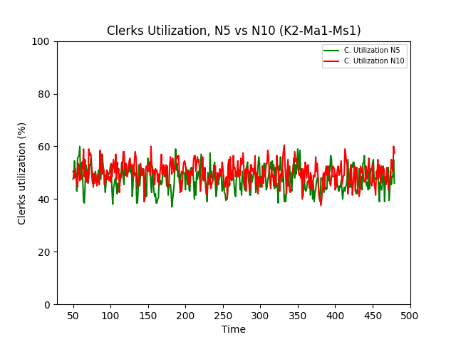
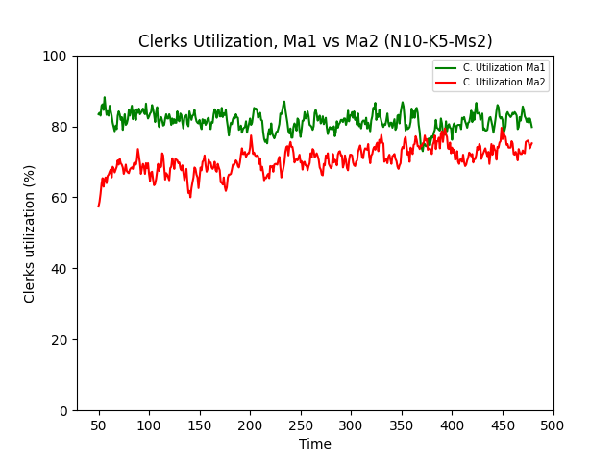
Results - Clerks Utilization
U = (#S / K) * 100
More N → Same U
More K → Same U
More Ms → More U
More Ma → Less U

Slide 12
Results
N | K | Ms | Ma | # W | # E | # S | U
5 | 2 | 1 | 1 | 2.76 (71%) | 13.43 (65%) | 0.96 (63%) | 48 %
10 | 2 | 1 | 1 | 7.36 (61%) | 8.26 (66%) | 0.99 (67%) | 50 %
10 | 5 | 1 | 1 | 4.57 (69%) | 6.57 (75%) | 2.33 (66%) | 46 %
10 | 5 | 2 | 1 | 4.98 (67%) | 9.04 (70%) | 4.07 (69%) | 81 %
10 | 5 | 2 | 2 | 3.42 (51%) | 2.68 (46%) | 3.53 (62%) | 70 %
(*) Percentage of values that are within one standard deviation away from the mean

Slide 13
Thanks for the attention!

